Slide 1

Comparison of HLS vs HDL in FPGA Design Flow
Pisula Mayan Guruge
Notes:
Hello everyone. My name is Pisula Mayan Guruge Today I’ll be presenting The Comparison of HLS vs HDL in FPGA Design Flow.
The goal of this presentation is to compare traditional HDL-based FPGA design with High-Level Synthesis, mainly focusing on productivity, performance, and how these approaches are actually used in practice.

Slide 2
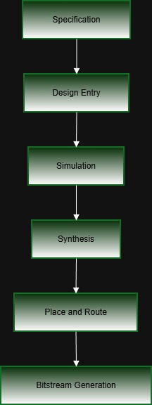
What is the FPGA Design Flow?
Notes:
Every FPGA project starts with system specification. This is where we define what the system should do, how fast it needs to run, and what constraints we have.
Next comes design entry. In a traditional approach, this means writing RTL using Verilog or VHDL. In an HLS-based approach, the design is written at a higher level instead.
After that, the design is simulated to verify functional correctness. Then it goes through synthesis, where it is mapped onto FPGA resources like LUTs, registers, block RAMs, and DSP blocks.
Following synthesis, placement and routing determine where the logic is physically placed on the FPGA and how it is connected. Finally, the bitstream is generated and programmed onto the FPGA.
If you look at the figure on this slide, it shows exactly this flow. The key takeaway is that regardless of whether we use HDL or HLS, the backend flow is the same. The main difference is how the design is described at the beginning.”

Slide 3
Abstraction Levels in FPGA Design
HDL → RTL-level, cycle-accurate
HLS → algorithmic level
Same final RTL output
Notes:
This slide focuses on abstraction levels in FPGA design.
With HDL, designers work at the register-transfer level. This is very close to the hardware and requires cycle-accurate descriptions.
With HLS, designers work at a higher, more algorithmic level. Instead of describing registers and clock cycles, they describe computations and data flow.
Even though the abstraction levels are different, both approaches eventually produce synthesizable RTL that is implemented on the FPGA.
So HLS mainly shifts effort away from manual RTL coding toward compiler-driven scheduling and optimization.”

Slide 4
HDL-Based FPGA Design Flow
RTL modeling using Verilog / VHDL
Explicit control of timing & resources
Manual pipelining and state machines
Predictable performance
Notes:
“Now let’s look at the HDL-based FPGA design flow in more detail.
In this approach, designers manually write RTL code using Verilog or VHDL. Hardware structure, timing, and data paths are explicitly defined.
Designers decide where registers go, how pipelines are built, and how state machines operate. This provides very strong control over performance and timing behavior.
Because of this level of control, HDL is still widely used for performance-critical and timing-sensitive designs.
However, this also means that the designer needs deep hardware knowledge, and development can take a long time, especially as designs become larger and more complex.”

Slide 5
Limitations of HDL-Based Design
Long development time
Manual design space exploration
Complex verification
Difficult maintenance for large designs
Notes:
“Despite its strengths, HDL-based design has several limitations.
Development time is often long, because everything is done manually. Exploring alternative architectures usually requires significant code changes.
Verification can also be complex and time-consuming, especially for large designs with many signals and pipelines.
Maintaining and modifying large RTL codebases can become difficult over time.
These limitations don’t mean HDL is bad — they represent the cost of having fine-grained control. They are also one of the main reasons why higher-level design approaches were introduced.”

Slide 6
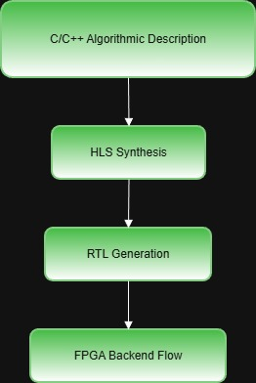
High-Level Synthesis (HLS) Overview
Design in C / C++ / SystemC
Compiler handles scheduling & binding
Directives control optimization
Focus on algorithmic behavior
Notes:
“High-Level Synthesis takes a different approach to FPGA design.
Instead of writing RTL directly, designers describe functionality using high-level languages such as C, C++, or SystemC. These descriptions focus on what the algorithm does, rather than how it is implemented cycle by cycle.
The HLS tool then performs scheduling, resource allocation, and binding to automatically generate RTL. Designers can guide this process using directives, for example to pipeline loops or increase parallelism.
If you look at the figure on this slide, it shows this clearly: the design starts from a C or C++ description, goes through HLS synthesis, generates RTL, and then enters the standard FPGA backend flow.
So HLS doesn’t remove RTL — it automates how RTL is created.”

Slide 7
Advantages & Challenges of HLS
Advantages:
High productivity
Rapid prototyping
Easy design space exploration
Challenges:
QoR predictability
Debugging generated RTL
Hardware knowledge still required
Notes:
“One major advantage of HLS is productivity. High-level code is usually shorter and easier to modify than RTL, which allows faster iteration and rapid prototyping.
HLS also makes it easier to explore different design options by changing synthesis directives instead of rewriting large parts of the code.
At the same time, HLS has challenges. The quality of the generated hardware depends on coding style and tool behavior.
Debugging generated RTL can be difficult, and hardware knowledge is still required to achieve efficient and predictable results.”

Slide 8
Comparative Analysis Overview
Productivity
Performance
Resource utilization
Power consumption
Verification complexity
Maintainability
Notes:
“To compare HDL and HLS fairly, both approaches are evaluated using the same criteria.
These include productivity, performance, resource utilization, power consumption, verification complexity, and maintainability.
The next few slides focus on the most important trade-offs between the two.”

Slide 9
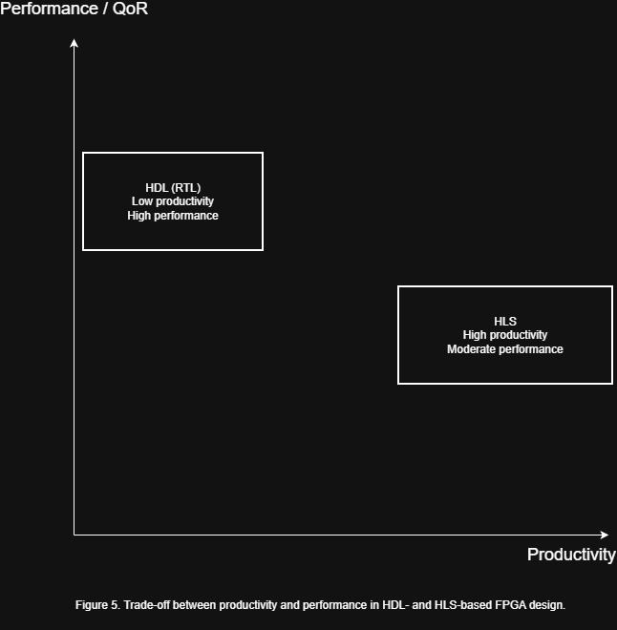
Productivity vs Performance
HDL → high performance, low productivity
HLS → high productivity, performance depends on tuning
Trade-off between abstraction and control
Notes:
“This slide shows the trade-off between productivity and performance.
HDL-based design typically offers very high and predictable performance, but productivity is lower because development and optimization are manual.
HLS-based design significantly improves productivity by raising the abstraction level, but performance depends on how well the design is optimized.
If you look at the figure, it visualizes this trade-off. HDL sits on the side of high control and high performance, while HLS shifts toward higher productivity.
So the key idea is abstraction versus control, not that one approach is always better than the other.”

Slide 10

Resource, Power & Verification
HDL: optimal resource & power control
HLS: faster exploration, possible area overhead
Verification:
HDL → signal-level debugging
HLS → multi-level verification complexity
Notes:
“When it comes to resource usage and power consumption, HDL gives designers direct control over hardware structures, which allows very efficient designs.
HLS automates many of these decisions, which simplifies development, but can lead to higher area or power usage if not carefully guided.
Verification also differs. HDL verification is signal-level and cycle-accurate, while HLS typically involves both algorithm-level and RTL-level verification.
Both approaches are challenging, but in different ways.”

Slide 11
Application Areas
DSP (FFT, FIR, filters)
Image & video processing
Machine learning accelerators
Rapid prototyping
Notes:
“In practice, both HDL and HLS are used across many application domains.
In digital signal processing, such as FFTs and FIR filters, HDL is often used when strict timing is required, while HLS is useful for exploring throughput and area trade-offs.
In image and video processing, HLS maps well to streaming pipelines, while HDL is commonly used for control logic and memory interfaces.
In machine learning acceleration, HLS is popular for algorithmic kernels, but HDL is still important for performance-critical components.
HLS is also widely used for rapid prototyping, especially in research and early development.”

Slide 12
Hybrid Design Flows & Future Trends
HLS for compute kernels
HDL for control & interfaces
AI-assisted synthesis
Domain-specific HLS tools
Heterogeneous computing (CPU + FPGA + GPU)
Notes:
“In many real-world projects, hybrid design flows are becoming common.
HLS is typically used for compute-intensive kernels, while HDL is used for control logic and interfaces.
Looking ahead, future trends include AI-assisted synthesis, domain-specific HLS tools, and increasing use of heterogeneous computing, where CPUs, GPUs, and FPGAs work together.
These trends further strengthen the role of HLS as a bridge between software and hardware.”

Slide 13
Conclusion
Key Takeaways:
HDL = control, predictability, performance
HLS = productivity, flexibility, fast iteration
Best results → hybrid workflows
Notes:
“To conclude, HDL-based design remains essential for applications that require maximum performance, predictable timing, and precise control.
High-Level Synthesis significantly improves productivity and flexibility, especially for algorithm-driven designs, but still requires hardware-aware optimization.
Rather than replacing HDL, HLS complements it, and modern FPGA design increasingly relies on combining both approaches.”

Slide 14
Thank You

Slide 15
References
[1] D. C. Zissulescu et al., “Raising the Level of Abstraction in FPGA Design,” IEEE Design & Test, vol. 35, no. 2, pp. 8–17, Apr. 2018.
[2] J. Cong and Z. Zhang, “An Efficient and Versatile Scheduling Algorithm Based on SDC Formulation,” IEEE Transactions on Computer-Aided Design of Integrated Circuits and Systems, vol. 25, no. 1, pp. 1–12, Jan. 2006.
[3] S. Hauck and A. DeHon, Reconfigurable Computing: The Theory and Practice of FPGA-Based Computation, IEEE Press, 2008.
[4] R. Tessier and W. Burleson, “Reconfigurable Computing for Digital Signal Processing,” IEEE Signal Processing Magazine, vol. 18, no. 3, pp. 24–38, May 2001.
[5] J. Bhasker, A SystemC Primer, IEEE Press, 2004.
[6] A. K. Verma and P. Ienne, “Improved Use of DSP Blocks in FPGABased Soft Processors,” IEEE Transactions on VLSI Systems, vol. 18, no. 3, pp. 450–463, Mar. 2010..

Slide 16
References
[7] J. Cong et al., “High-Level Synthesis for FPGAs: From Prototyping to Deployment,” IEEE Transactions on Computer-Aided Design of Integrated Circuits and Systems, vol. 30, no. 4, pp. 473–491, Apr. 2011.
[8] S. Gupta et al., “SPARK: A High-Level Synthesis Framework for Applying Parallelizing Compiler Transformations,” IEEE Transactions on Computer-Aided Design, vol. 22, no. 3, pp. 281–295, Mar. 2003.
[9] J. Cong and Y. Zou, “FPGA-Based Hardware Acceleration of Machine Learning Algorithms,” IEEE Micro, vol. 39, no. 4, pp. 19–28, Jul. 2019.
[10] P. Coussy and A. Morawiec, High-Level Synthesis: From Algorithm to Digital Circuit, Springer / IEEE, 2008.
[11] S. L. Harris and D. M. Harris, Digital Design and Computer Architecture: ARM Edition, Morgan Kaufmann, 2016.
[12] X. Yang, Integrated Circuit Design: IC Design Flow and Project-Based Learning, Springer, 2020

